Slide 1
LIGHTCAST · AD688 · GROUP 1
Business Running Case:
Evaluating Personal Job Market Prospects in 2024
Analyzing
the Data
Job Market
Omar, Ricardo, Tianyi, Yingyi, Zichen

Slide 2

72,000+
Job Postings
Analyzed
15+
Unique Skills
Extracted
Goal:
Understand how AI, geography, and skills shape job opportunities
Key question:
Where are the opportunities, and what skills matter most?
18
Industry Sectors
Covered

Slide 3
AGENDA
Contents
Data &
Cleaning
Machine
Learning
Key
Insights
8 Research
Questions
Job Cluster
Finder
AD688 · Lightcast Job Postings · Group 1 · Spring 2025

Slide 4
DATA & CLEANING
Data Cleaning Pipeline
Raw: data/lightcast_job_postings.csv → Output: data/lightcast_cleaned.csv
1
Load Raw Data
7
Clean Salary Fields
72,498 rows
42.5% have salary
72,498 rows × 131 columns from lightcast_job_postings.csv
Clip to $20K–$500K annual; flag valid salary rows
2
Select Columns
8
Remote Work Categories
25 columns kept
Remote: 15,884
Keep 25 of 131 columns: skills, industry, geography, remote, salary, education, timing
Collapse to: Remote · Hybrid · On-site (null = On-site)
3
Standardize Column Names
9
Parse Skills (JSON)
Lowercase + underscore names for consistency across teammates
Lightcast stores skills as JSON arrays — parse to clean Python lists
4
Parse Dates
10
Standardize Geography
51 states covered
Convert posted/expired to datetime; derive posted_year and posted_month
Strip whitespace and fix casing on state, city, county, MSA fields
5
Drop Missing Rows
−44 rows
Remove rows with no posting date or job title
Deduplicate
72,454
29
May–Sep 2024
5,719
0 dupes found
Dedupe on ID; fall back to title + company + date
Clean rows
Final columns
Date range
Unique job titles

Slide 5
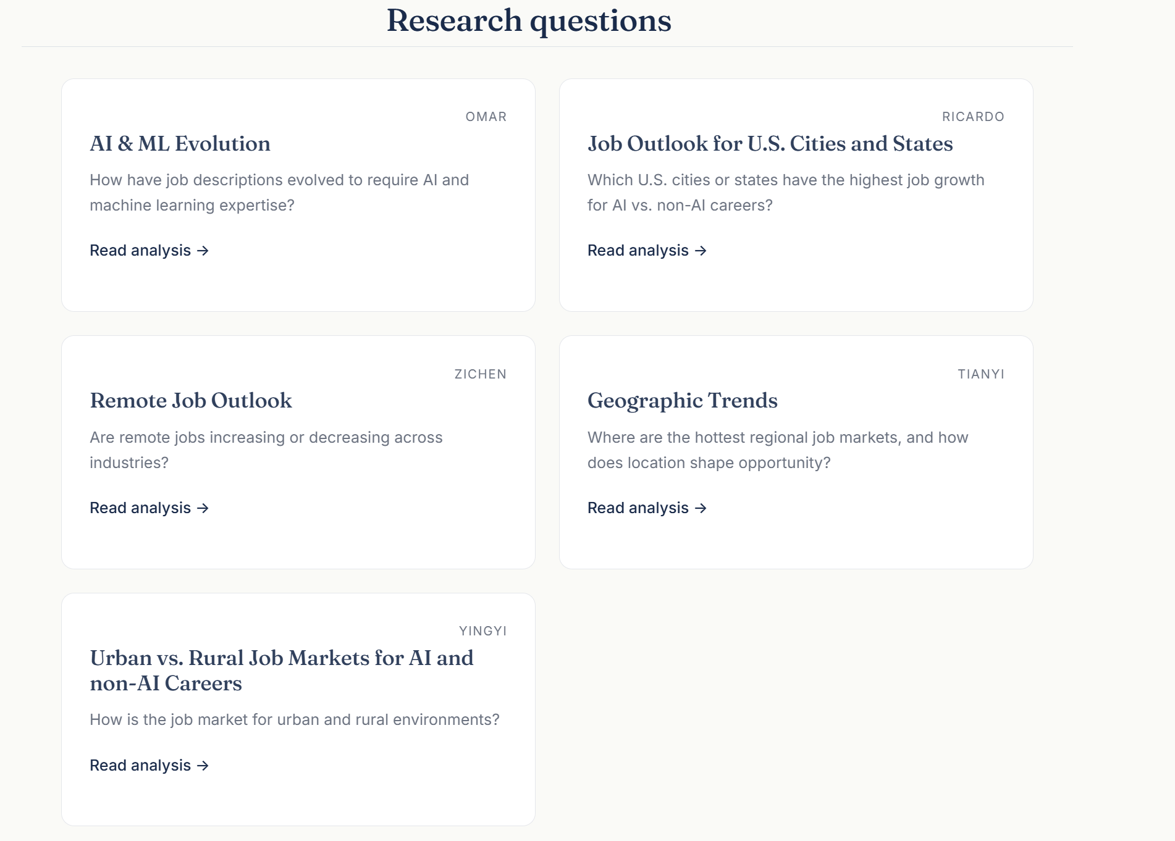
4 Research Questions & EDA

Slide 6
RESEARCH QUESTION
Which U.S. Cities or States Have
the Highest Job Growth for
AI vs. Non-AI Careers?
Ricardo Marin Fernández-Conde

Slide 7
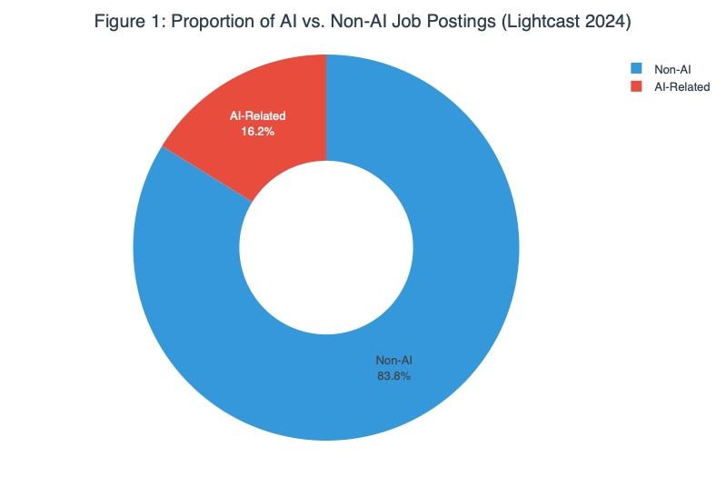
Methodology & AI Labeling
72,454 Lightcast postings May–Sep 2024 21 keyword patterns ML, deep learning, NLP, computer vision, PyTorch, TensorFlow, LLM, generative AI ~16% classified as AI-Related Stanford AI Index: 1.4% → 1.8% nationally

Slide 8
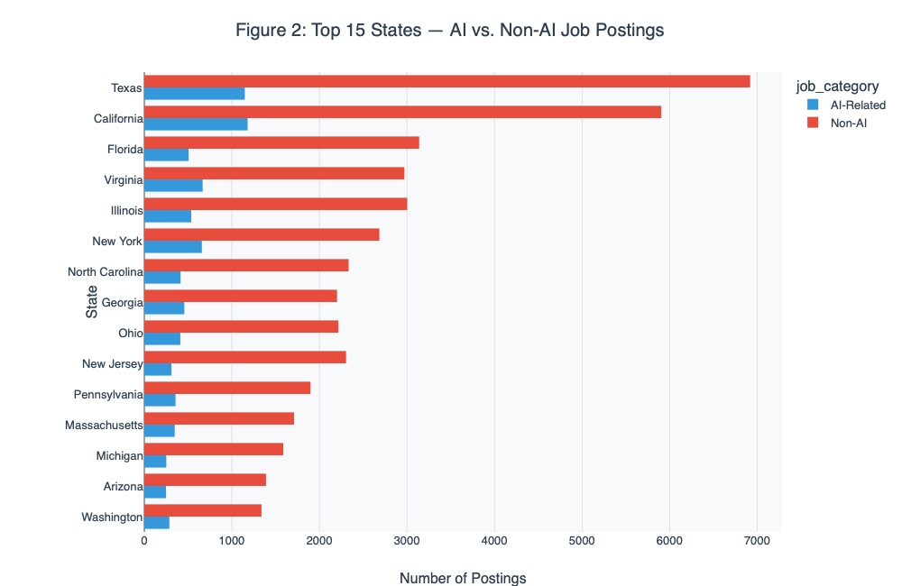
Top States: AI vs. Non-AI Volume
Key Findings CA & WA have a higher AI share relative to their total FL & OH are overwhelmingly non-AI Matches UMD-LinkUp: CA, TX, VA, NY, MA

Slide 9
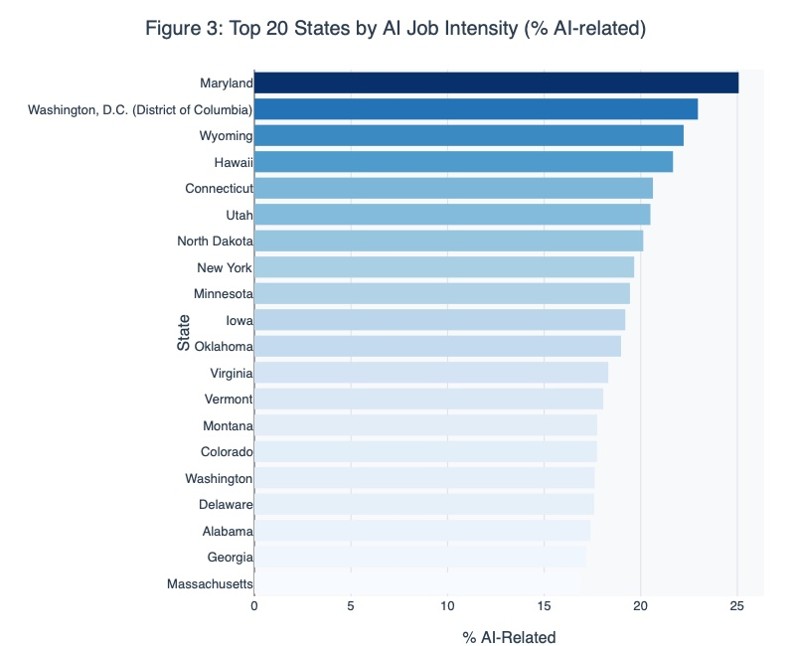
AI Intensity: Which States Specialize?
Volume ≠ Intensity MD, DC, WY & HI lead in AI share TX & FL drop out — AI gets diluted by non-AI volume UMD-LinkUp confirms: DC, VA, WA lead intensity

Slide 10
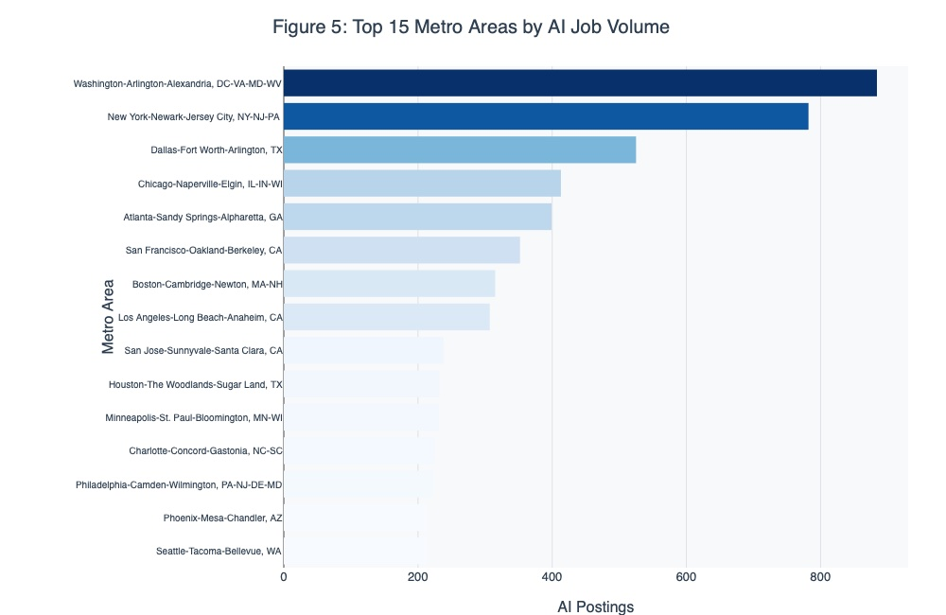
Metro-Level: Where AI Hiring Concentrates
Top 3: Diversified Metros
DC, NYC, Dallas-FW
Defense, finance, corporate services
Also Notable: Tech Hubs
SF (#6), Boston (#7), San Jose (#9)
Rank lower than expected

Slide 11
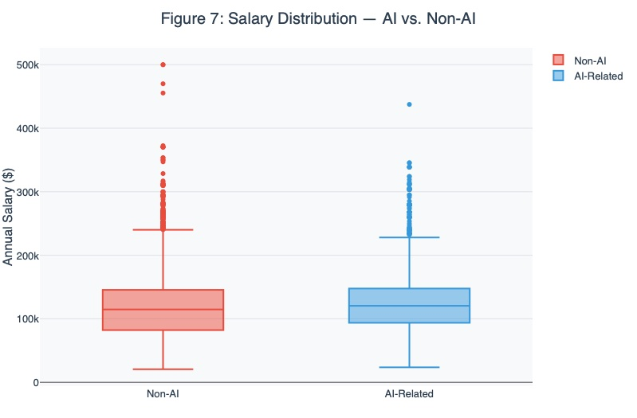
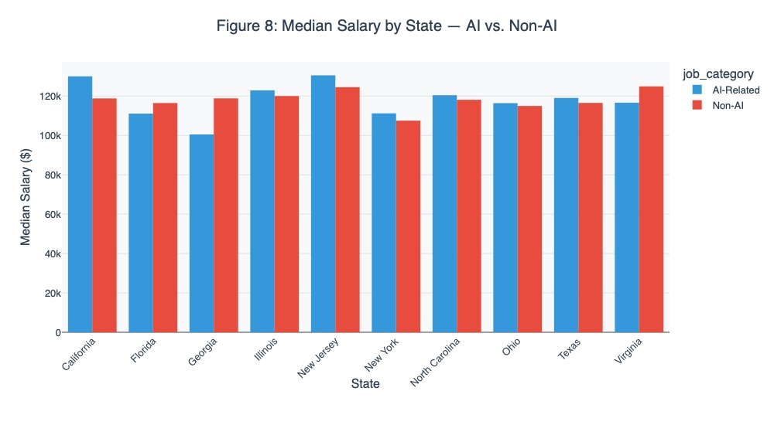
The AI Salary Premium
AI roles pay more in every state. ITIF: 16.7% wage growth in AI sectors vs. 7.5% nationally since 2022.

Slide 12
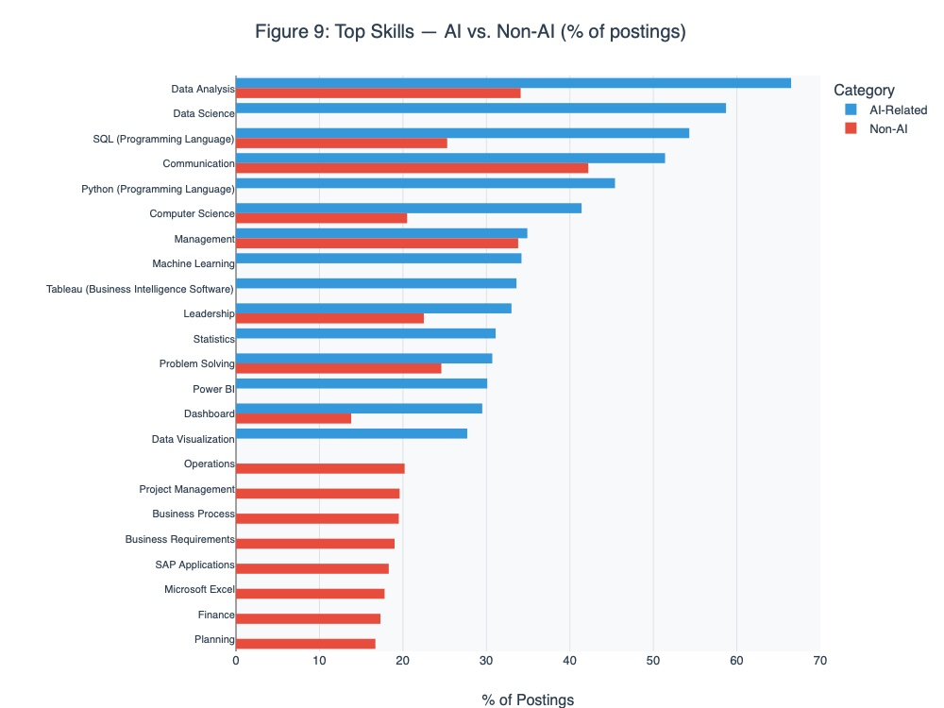
Top Skills: AI vs. Non-AI Postings
Top (AI-dominant): Data Analysis, Data Science, SQL, Python, ML Middle (shared): Communication, Management, Tableau, Statistics Bottom (Non-AI only): Operations, Project Mgmt, SAP, Excel, Finance, Planning

Slide 13
The Geographic Split
AI careers and non-AI careers follow different geographic patterns
 | AI Careers | Non-AI / Broad Growth
Leading States | CA, TX, VA, WA, MA, NY, DC | FL, TX, ID, WY, NV, AZ
Leading Metros | DC, NYC, Dallas-FW, Chicago, Atlanta, SF | Dallas-FW, Austin, Tampa, Miami
Main Drivers | R&D, defense, venture capital, elite universities | Population growth, healthcare, construction, tourism
Median Salary | $90K - $160K+ | $50K - $100K
Texas appears in both columns — the only state that bridges AI and broad growth.

Slide 14
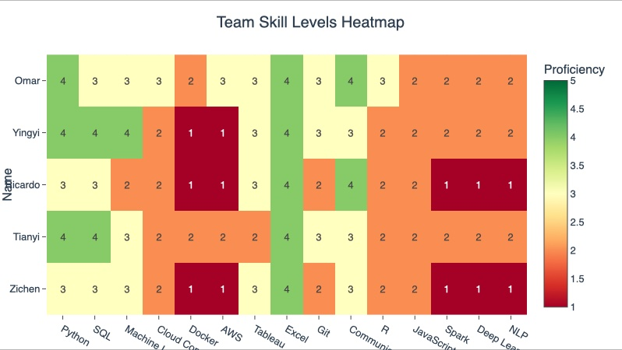
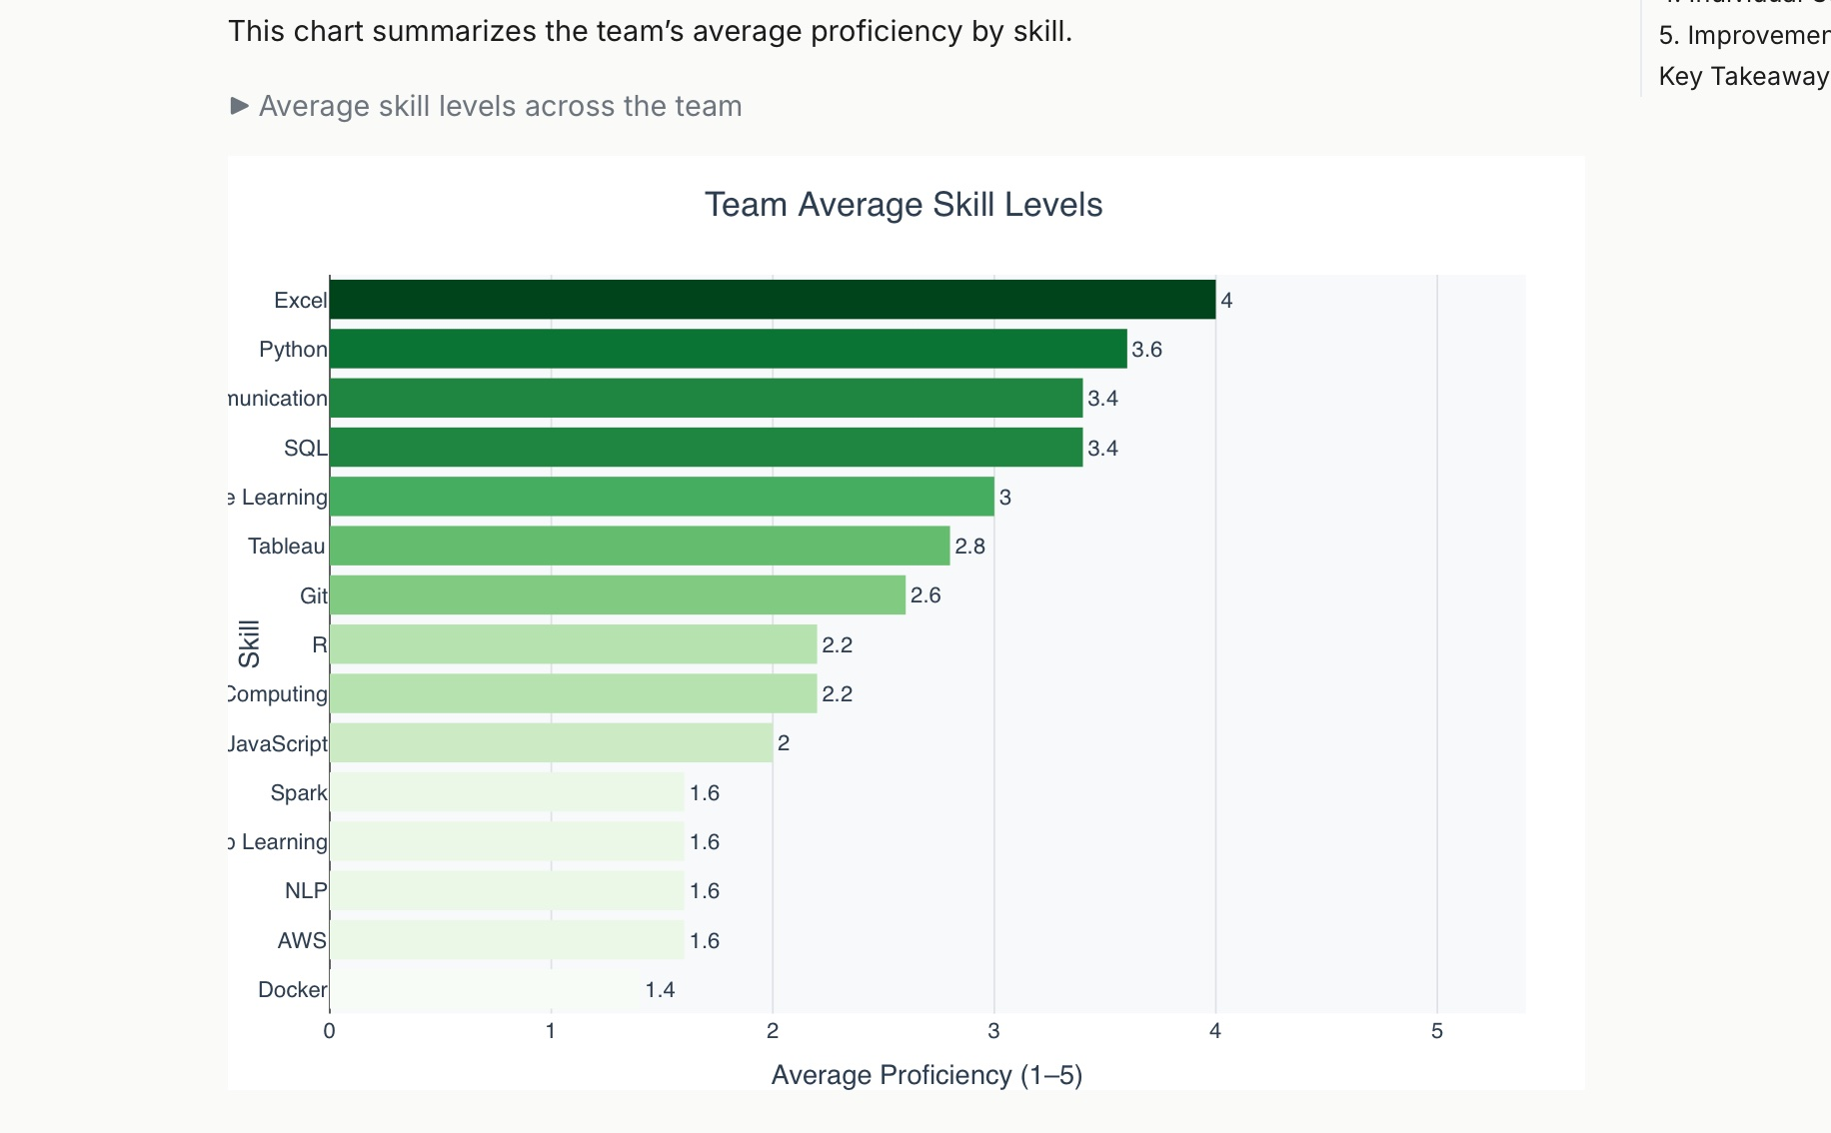
Skill Gap: Team vs. Market Demand
Strongest: Excel (4.0), Python (3.6), Communication (3.4), SQL (3.4) — team exceeds market needs. Weakest: Docker (1.4), AWS (1.6), Spark (1.6), Deep Learning (1.6), NLP (1.6). Peer teaching: Yingyi & Tianyi → Python & ML | Omar → Excel & Cloud | Ricardo → Communication

Slide 15
Key Takeaway
The U.S. labor market has two geographic tracks
AI Track
Broad Growth Track
DC, NYC, Dallas, Chicago, Atlanta, SF
CA, TX, VA, WA, MA, NY, DC
Python, ML, cloud skills required
Salaries $90K-$160K+
Sun Belt: FL, TX, ID, AZ, NV
Healthcare, construction, services
Communication, mgmt, Excel skills
Salaries $50K-$100K
The Bridge: Texas — #2 in AI volume, #2 in talent attraction, most jobs added in 2024. Austin & Dallas-FW combine both tracks.

Slide 16
RESEARCH QUESTION
Urban vs. Rural Job Markets for AI and Non-AI Careers
Yingyi

Slide 17
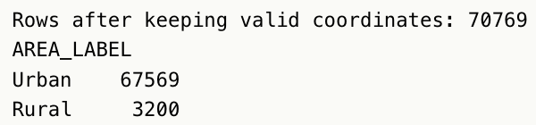
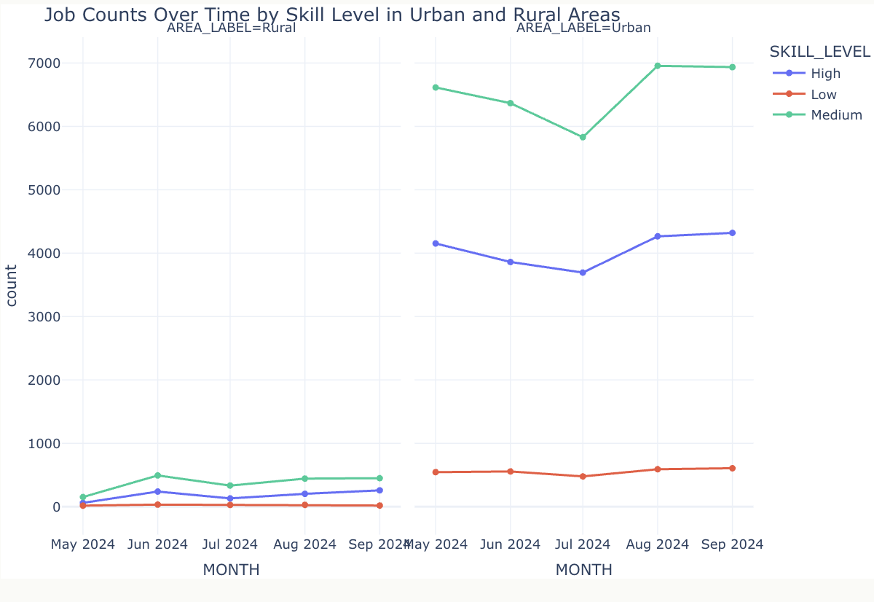
Urban Concentration
Urban ≈ ~21 *Rural job quantity
Reference: official US urban area boundary data (tl_2020_us_uac20_corrected.shp)
The core demand in the labor market focuses on "medium skills"
The urban economy relies more on operational / technical / intermediate positions
The urban employment market is more active but more volatile vs the rural employment market, which has a smaller scale but is relatively stable

Slide 18
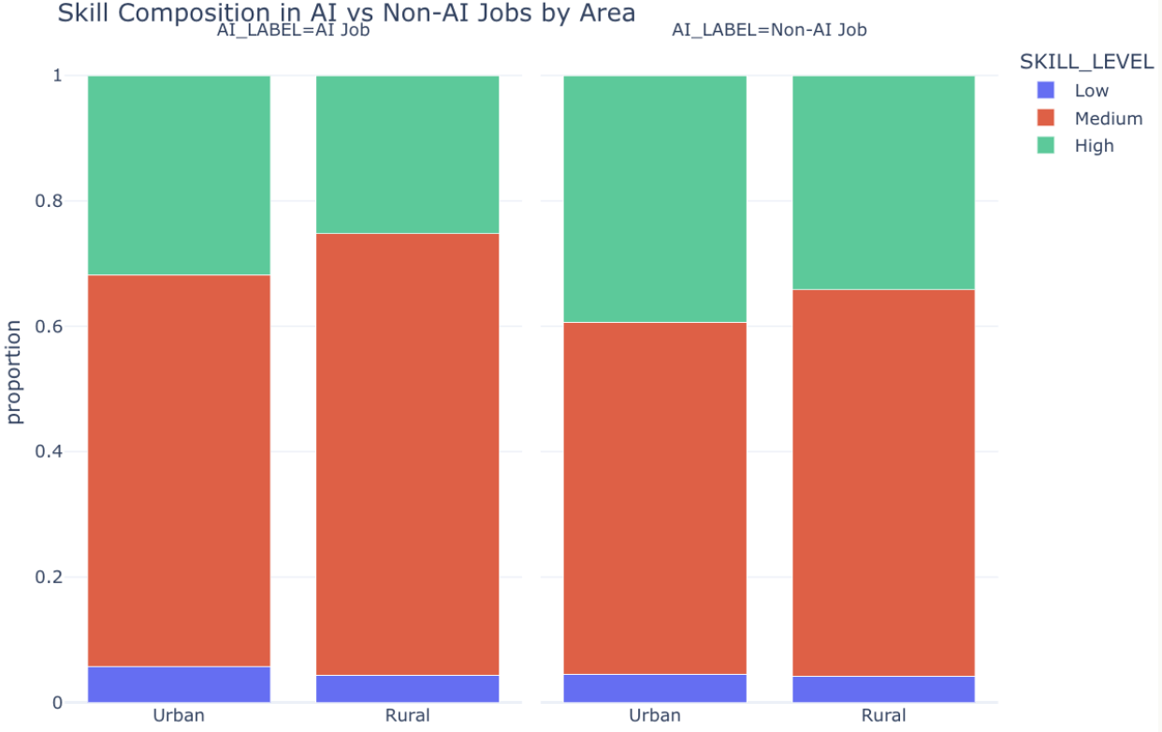
Skill Shift
Low-skill stable
Similar proportion across all groups
Not affected by AI or area
Urban vs Rural pattern unchanged
Urban → more High-skill
Rural → more Medium-skill
Same in AI & Non-AI
Non-AI has more High-skill
Higher share than AI jobs
AI not yet high-skill dominant

Slide 19
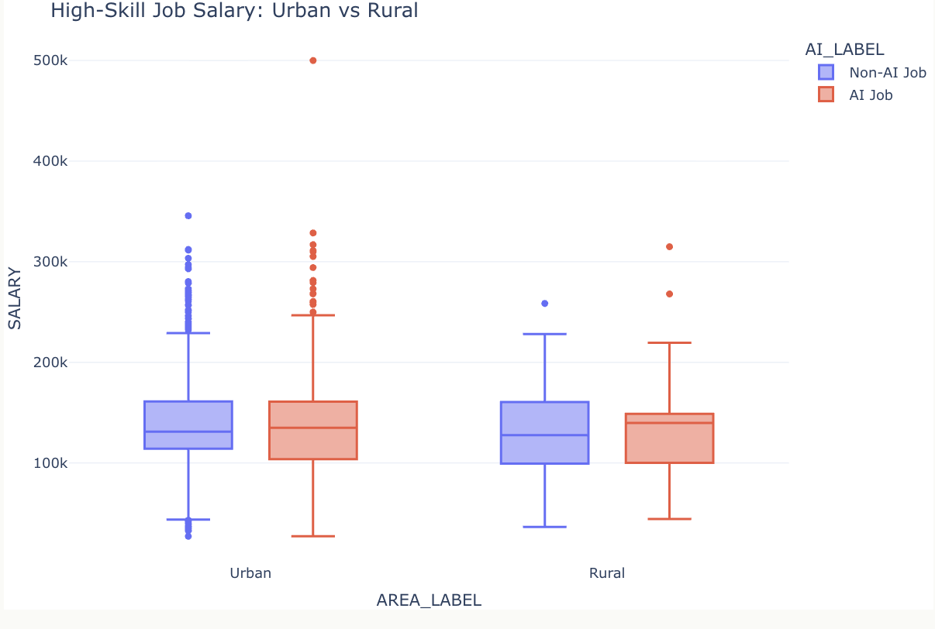
Uneven Benefits
AI premium = limited
Slightly higher median
Heavy overlap with Non-AI
Not a decisive factor
Salary drivers ≠ AI label
AI vs Non-AI gap → small
Overall range → wide
Driven by role / experience
Urban vs Rural gap = minimal
Similar medians
Similar distributions
Weak location effect (for high-skill jobs)
AI boosts upside, not baseline
Higher upper bound (outliers)
More extreme high salaries
No broad income lift

Slide 20
RESEARCH QUESTION
Do tech hubs still dominate AI-related hiring, or are other locations emerging
Tianyi

Slide 21
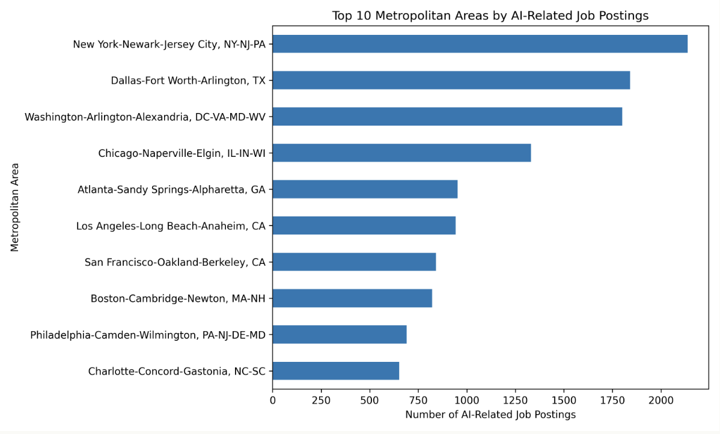
AI Hiring Is Still Strong in Major Tech Hubs
Major cities dominate AI job postings
Top metros: New York, San Francisco, Boston, Seattle
Strong ecosystems - talent, capital, infrastructure
Growth driven by industry adoption, not tech dominance
AI becoming a cross-industry capability
Expansion reflects rising demand outside core hubs

Slide 22
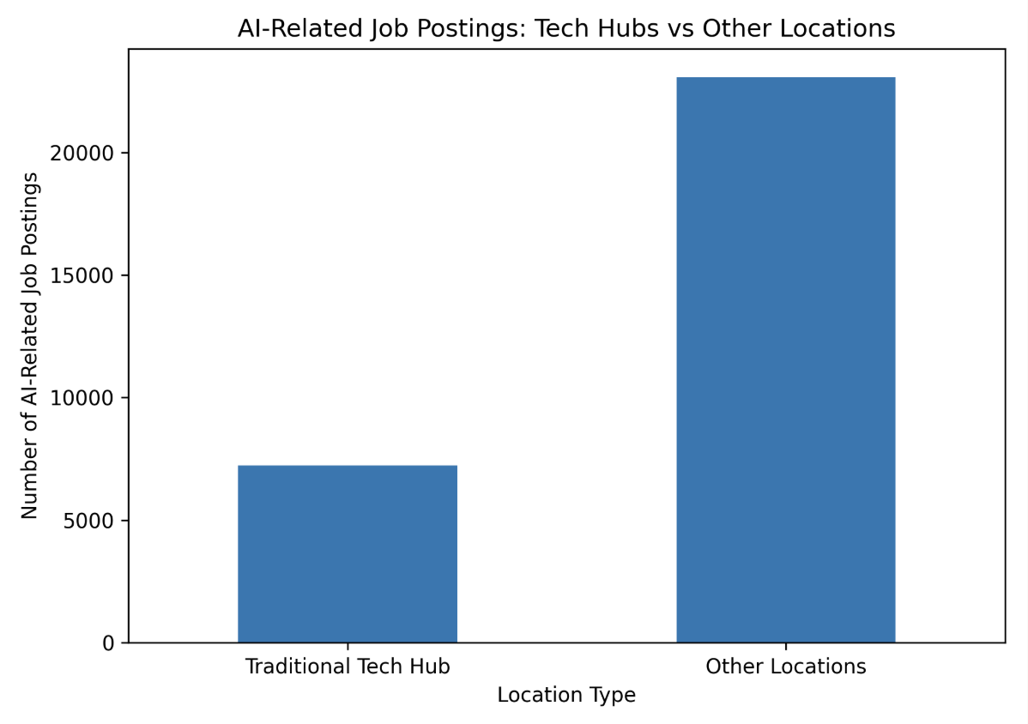
Tech Hubs No Longer Dominate AI Hiring
Tech hubs still strong individually
But Other Locations > Tech Hubs (total AI jobs)
Shift from centralized to distributed growth
AI demand expanding across multiple regions

Slide 23
Final Takeaway
AI Hiring Is More Geographically Distributed
· AI jobs remain strong in major tech hubs
· A larger share of AI jobs is found outside these hubs
· This shows AI hiring is not limited to a few key cities
· Job seekers can consider a wider range of locations

Slide 24
EXPLORATORY DATA ANALYSIS
Q1
Most In-Demand Skills
ML, BA &
DS Trends
Q2
AI/ML Evolution in Job Descriptions
Q3
Four research questions examining how AI/ML skills,
industry demand, and career outlook are shifting
across the 2024 Lightcast job postings dataset.
Industries Hiring Data Scientists
Q4
BA Career Outlook

Slide 25
Q1 · ML, BA & DS TRENDS
Most In-Demand Skills
across DS, BA & ML roles · 72,454 postings
Top Skills Overall
DS / ML Roles
BA / BI Roles
Communication
44%
(585 postings)
(71,869 postings)
· Data Science 77.6%
· Comm. 43.7%
Data Analysis
39%
· Python 53.5%
· Data Analysis 39.1%
· SQL 52.0%
· Management 34.0%
Management
34%
· Math 41.7%
· SQL 29.8%
· ML 41.0%
· Problem Solving 25.5%
SQL
30%
· Statistics 39.8%
· Leadership 24.1%
Problem Solving
26%
Leadership
24%
Python
17%
Key insight: SQL + Communication are the only skills that rank top-5 in BOTH role families.

Slide 26
Q2 · ML, BA & DS TRENDS
AI/ML in Job Descriptions
Have job descriptions evolved to require AI/ML expertise?
AI/ML Adoption by Month
11.4%
9.3%
9.9%
8.6%
9.1%
7.6%
of postings require
AI/ML skills
May '24
Jun '24
Jul '24
Aug '24
Sep '24
Top AI/ML skills demanded:
Machine Learning
8,016
Artificial Intelligence
6,280
Gen AI
2,280
TensorFlow
591
NLP
566
Key insight: AI/ML demand grew from 7.6% → 11.4% in just 5 months — a clear upward trajectory.

Slide 27
Q3 & Q4 · ML, BA & DS TRENDS
Industry Hiring & BA Career Outlook
Q3: Which industries hire the most data scientists?
Q4: What is the career outlook for BA professionals?
14,214 data science postings (19.6% of all)
21,184 BA-related postings (29.2% of all)
Prof. & Scientific Services
25%
15,197
5,294
Admin & Support Services
16%
Data Analytics roles
Business Analytics / BI
Finance & Insurance
10%
Information / Tech
6%
42.5%
Remote
22%
Healthcare
5%
Postings with salary data
Remote availability
Manufacturing
5%
Key insight: Professional services dominates DS hiring; BA demand is strong but shifting toward data analytics titles.

Slide 28
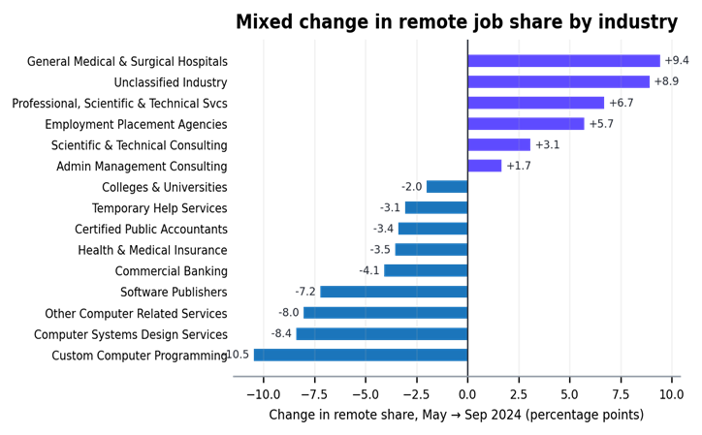
REMOTE WORK ACROSS INDUSTRIES
Are Remote Jobs Increasing or Decreasing?
Lightcast postings · top 15 industries · May–September 2024
What changed?
72,498
Job postings
No uniform trend
Remote share rose in some industries and declined in others.
15
Hospitals +9.4 pp; professional/scientific services +6.7 pp.
Largest industries
Top increases
Custom programming −10.5 pp; computer systems design −8.4 pp.
May → Sep
Top declines
2024 window
Key insight:
Remote work in 2024 is industry-specific — job seekers should evaluate flexibility by sector, not by the overall market average.

Slide 29
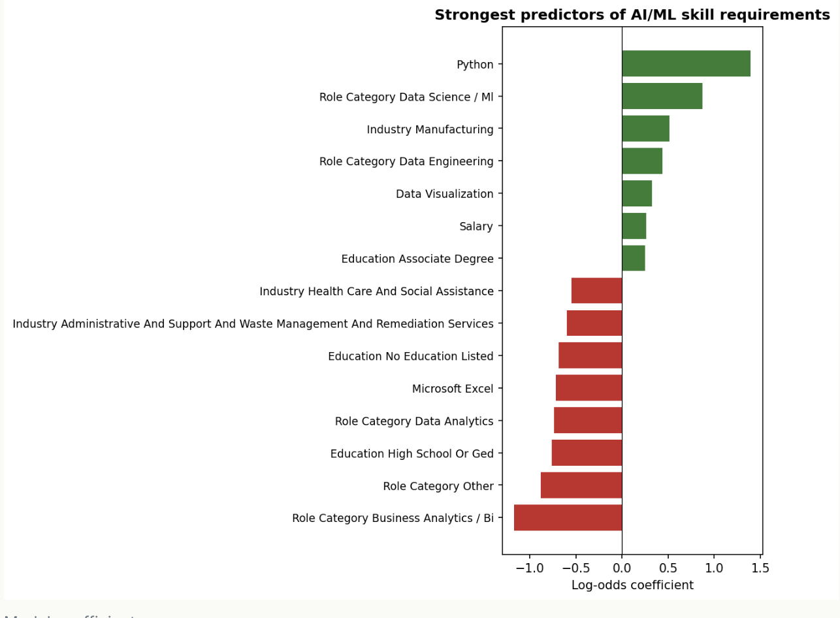
Machine Learning
Predicting AI/ML Skill Requirements
Logistic regression model (Accuracy: 0.91, AUC: 0.75)
Python & Statistics → strong signals of AI demand
Excel / BI tools → less likely to require AI skills
AD688 · Lightcast Job Postings · Group 1 · Spring 2025

Slide 30
JOB CLUSTER FINDER · ML FEATURE
Find Your Job Cluster
Discover which segment of the job market best matches your skills
How It Works
10 Role Clusters Identified
1
~50K postings encoded as 200-dim binary skill vectors
Data Science & ML
Operations & Logistics
2
TF-IDF reweighting to boost distinctive skills (PyTorch > Communication)
Business Intelligence & Reporting
Cloud & DevOps
3
L2 normalization + K-Means clustering into k = 10 role families
Software Engineering
Marketing & CRM
4
User picks their skills → cosine similarity match to nearest centroid
Healthcare & Clinical
HR & Talent Analytics
5
Returns top cluster + 2 runner-ups with salary, titles & industries
Finance & Accounting
Government & Public Sector
Interactive tool: Select your skills → instantly matched to a job cluster with salary, titles & industries.
yingyig72.github.io/ad688-employability-sp25A1-group1/cluster_finder.html

Slide 31
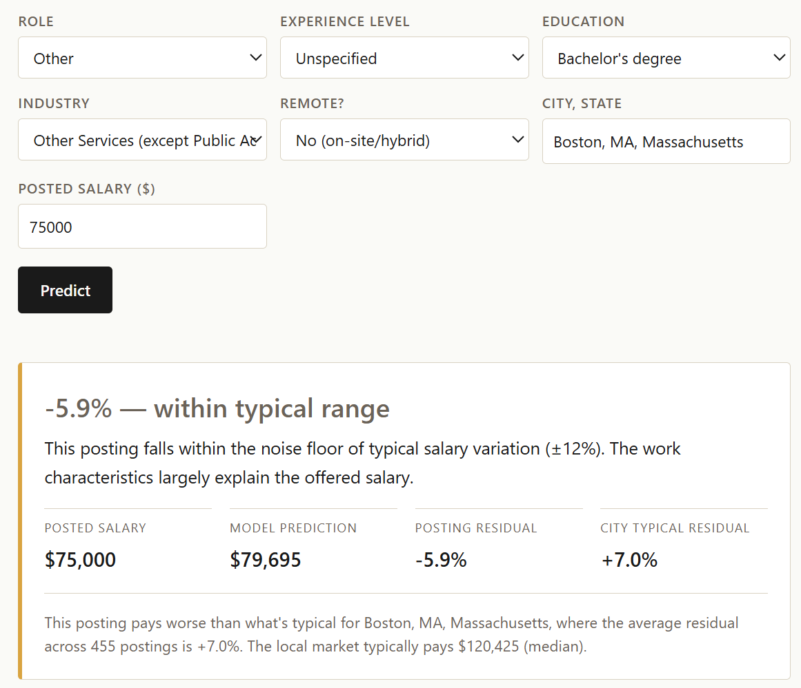
SALARY FAIRNESS · ML FEATURE
Salary Fairness
How it works
Paste a job description
Tool auto-detects job features
User enters city + salary
Model predicts expected salary
Output labels the posting as Premium, Fair, or Discount
Technical backend:
Trained model on Lightcast job postings
Used job features, not geography, to predict salary
Residual = actual salary − predicted salary
City residuals show whether a location typically pays above or below expectation
Ridge model exported to JSON so the predictor runs in the browser

Slide 32
Thank you!

Slide 33
Conclusion & Career Implications
The job market is increasingly skill-driven, not title-driven
Key Insights
AI jobs are growing but concentrated in major urban hubs
Non-AI job growth is broader across regions
Skills (e.g., Python, SQL, communication) matter more than job titles
Implications
Focus on building transferable skills (SQL, Python, analytics)
Be strategic about location and industry choice
Combine technical + business skills for better opportunities

